Slide 1
SOLUTION OF FLOW INSIDE ISOLATOR
Notes:
We solved for differential equations in M. Smart’s paper with adiabatic assumption.
Then we compared the results with Billig’s experimental results.

Slide 2
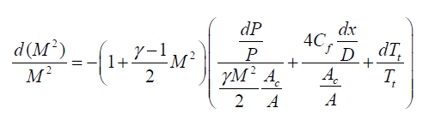
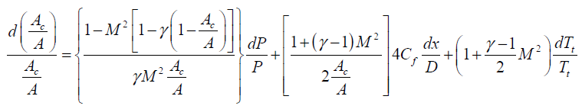
EQUATIONS
These equations are taken from M. Smart’s research paper.
(1)
(2)

Slide 3
(3)
Now, by substituting (3) into (1) and (2) and taking dT_t/T_t = 0 (adiabatic), and rewriting A_c/A = r(x) (ratio), we get
(4)
(5)
Notes:
x = 0 is the isolator entry.

Slide 4
Using (3), (1), (2) and isentropic relation between p_t and p, we can derive:
(6)
The equations (3), (4), (5) and (6) are given to Maple (a software like Mathematica) with the following initial conditions:
M(0)=2.231, p(0)=36515, p_t(0)=409384.4, r(0)=1
The values of gamma, C_f and diameter are taken to be:
Notes:
The initial conditions for M, p and p_t are taken from Table 1 of (Research/Technical Note)
“Analysis of a Dual-Mode Scramjet Engine Isolator Operating From Mach 3.5 to Mach 6” (2016) by Vu Ngoc Long, Luu Hong Quan, Nguyen Phu Hung, Le Doan Quang.

Slide 5
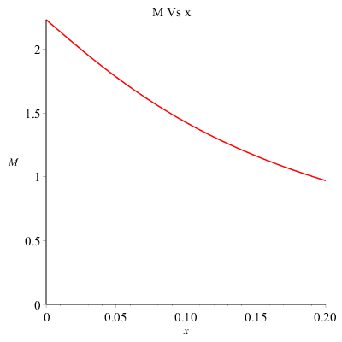
PLOTS Numerical solutions are obtained for x from 0 to 0.2 m.
(m)
Notes:
In this analysis, the shock train starts at isolator inlet.
x is in metres.

Slide 6
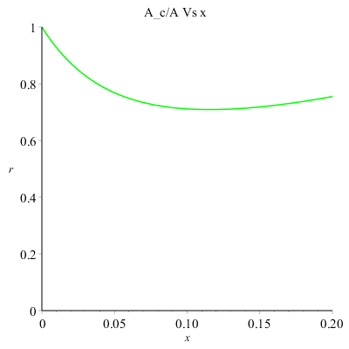
(m)

Slide 7
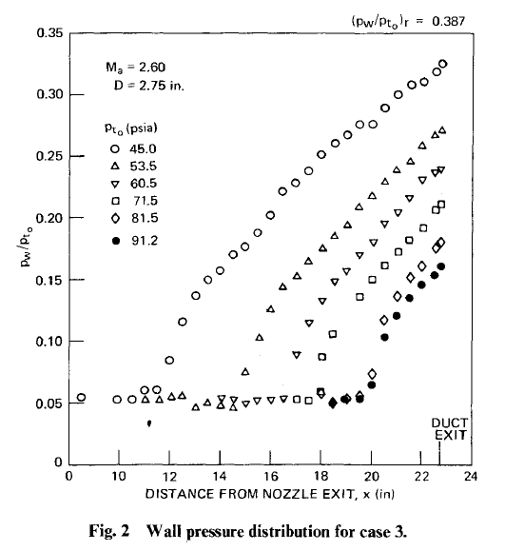
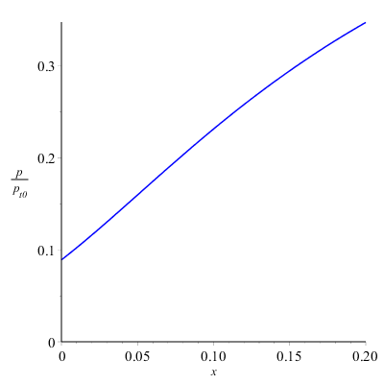
Comparison with Billig’s plot ( p/p_t0 Vs x)
(m)
Notes:
Pressure p is in Pa. Comparison is qualitative.

Slide 8
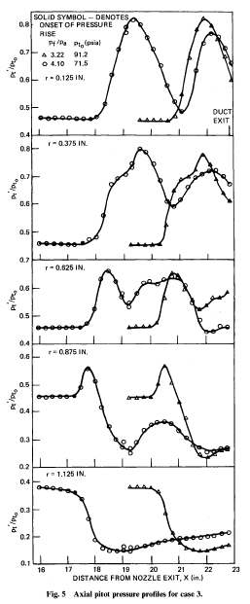
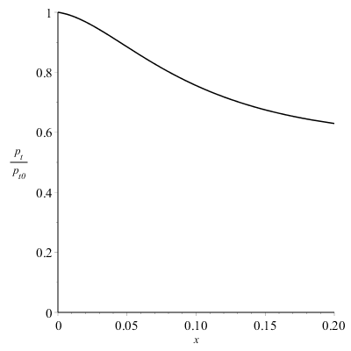
Comparison with
Billig’s plot ( p_t/p_t0 Vs x)
(m)
Notes:
Total pressure is in Pa.

Slide 9
CONCLUSION
After comparing with Billig’s experimental results (qualitatively), we can see that total pressure plot does not match with experimental plots.
The pressure Vs x plot matches qualitatively with experimental plots except that the constant pressure plateau in the beginning is missing.

Slide 10
Thank You
By
Ankit
& deependra

